Slide 1
Welcome to the world of Cambrian Multimedia presentation.

Slide 2
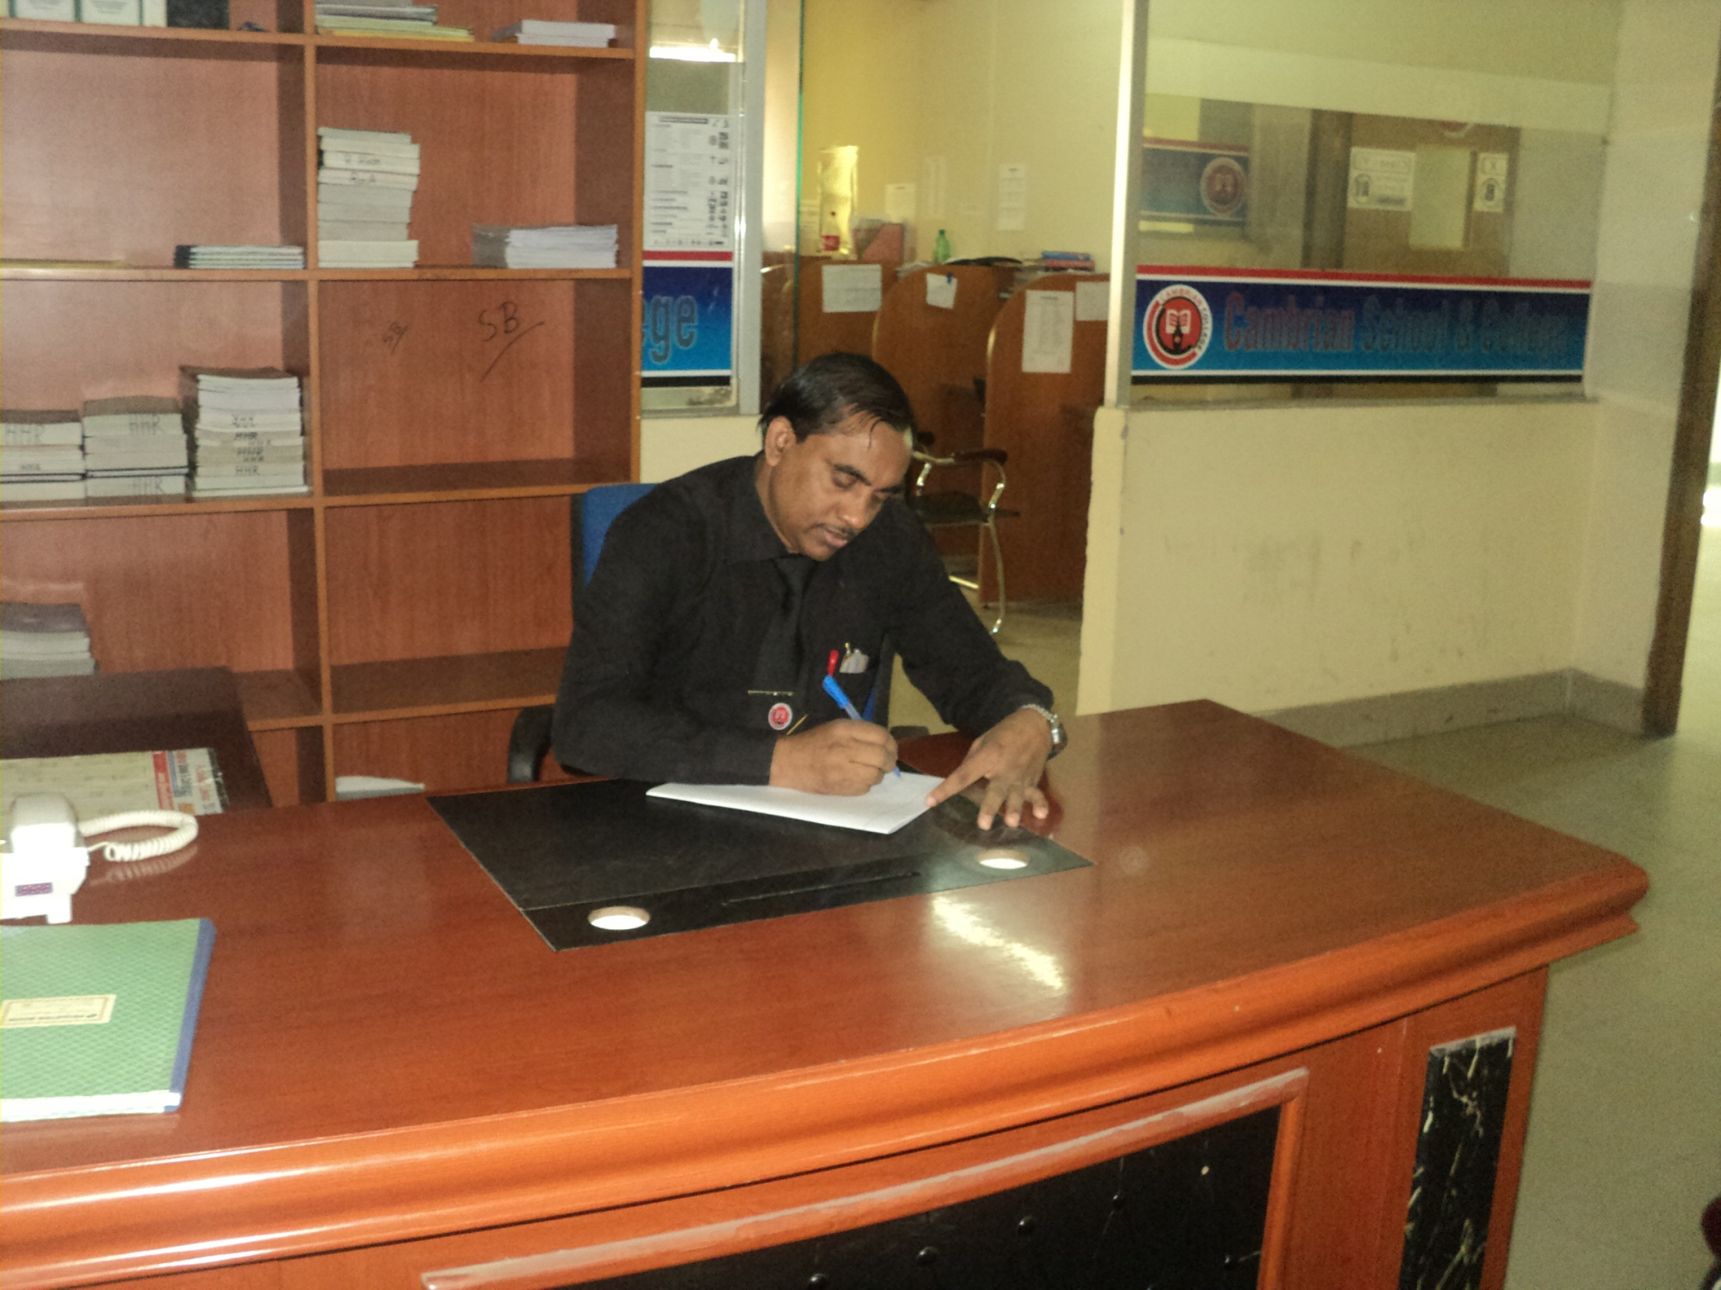
Mr Hasan
Senior Lecturer
Department of English
Cambrian School & College,Dhaka,
Class-Nine
English
1st Paper

Slide 3
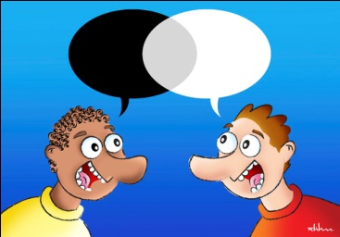
Dialogue

Slide 4
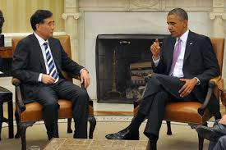
Dialogue

Slide 5
Let us watch a video
Learning English

Slide 6
Our Today’s Lesson is-
A dialogue on
“Importance of learning English”

Slide 7
Learning outcomes
After we have studied this lesson we will be able to-
be curious to learn English
eager to speak English
practice English
write a dialogue in English.

Slide 8
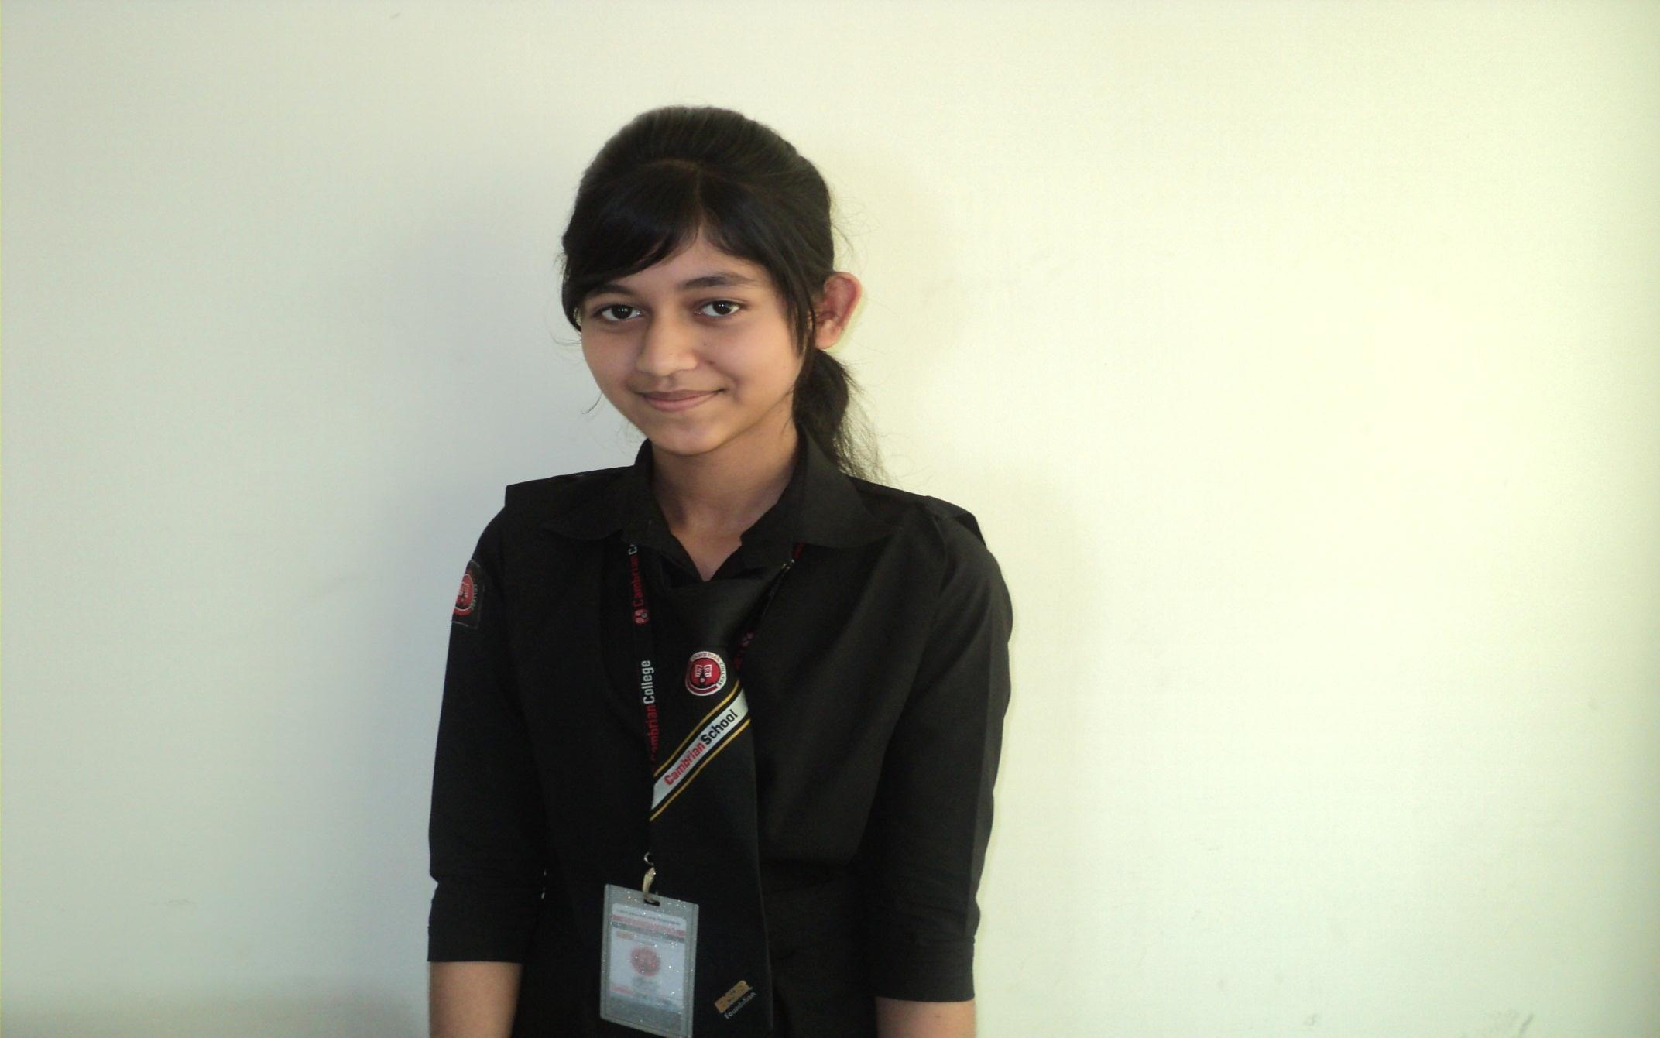
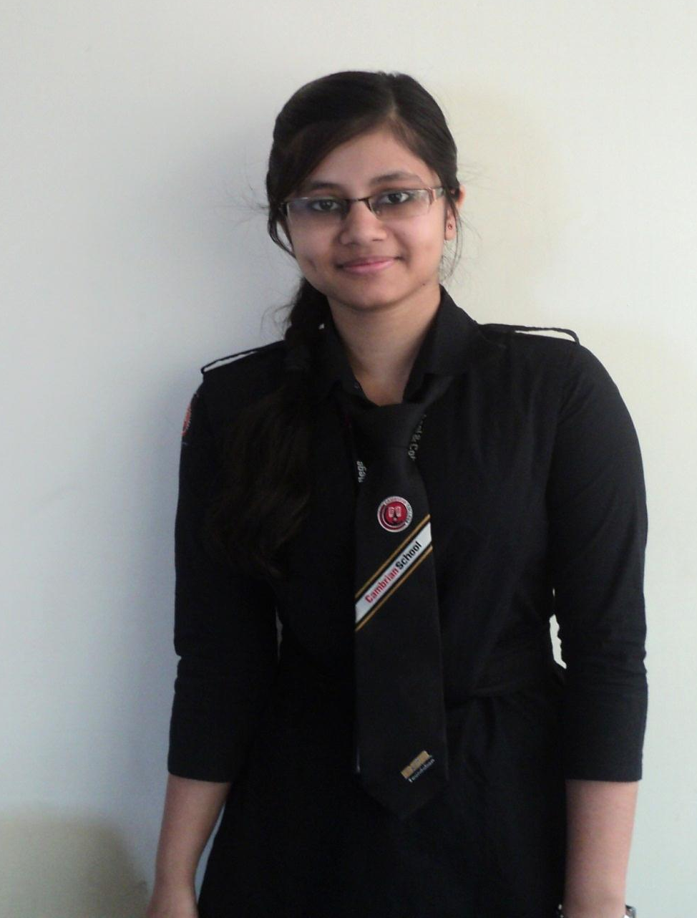
Ayesha
Mumu
Ayesha and Mumu are friends.

Slide 9
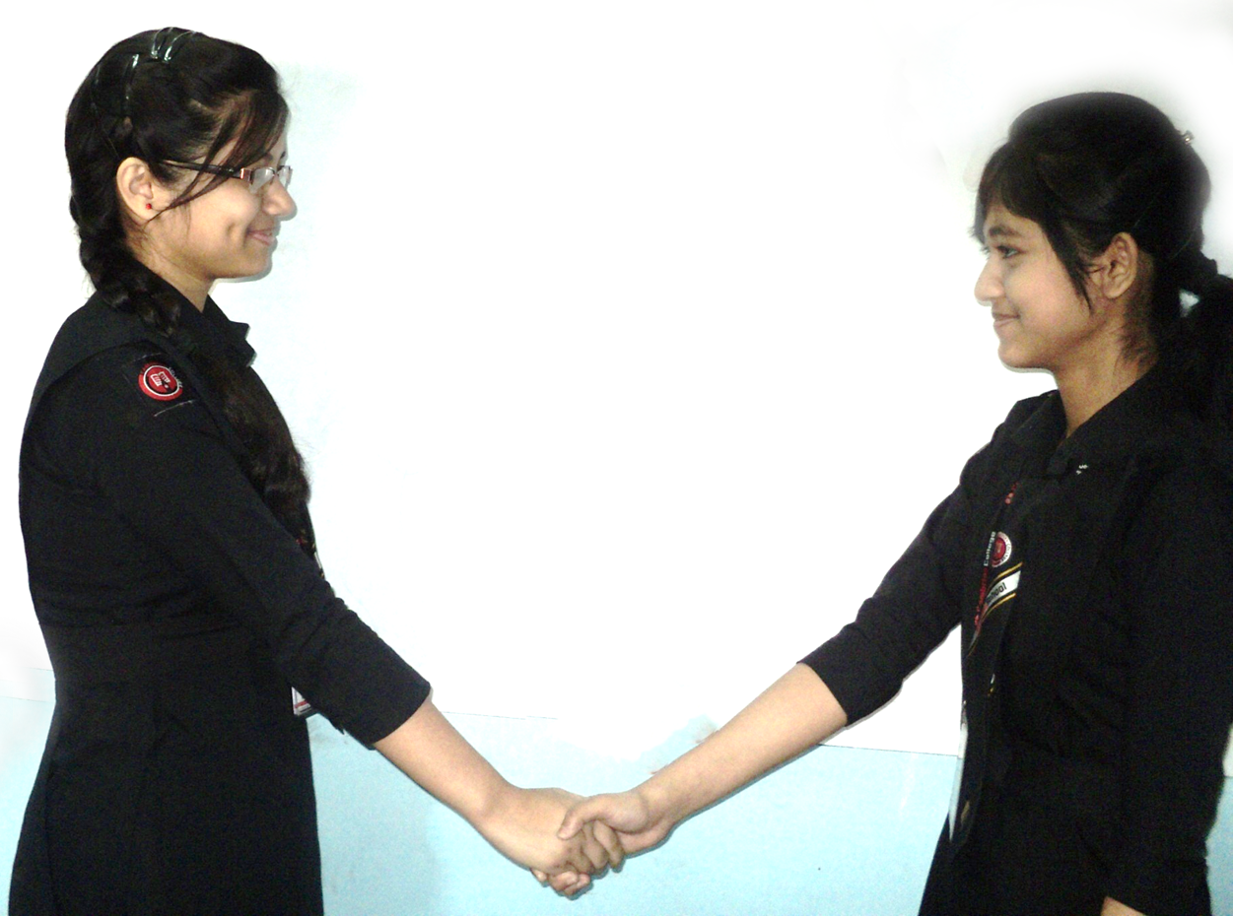

Hi friend, How are you?
I am fine and you?

Slide 10
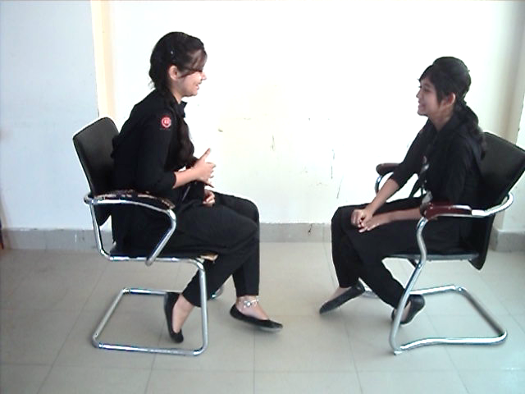
I am also fine. What were you doing?
I was reading an English newspaper.

Slide 11
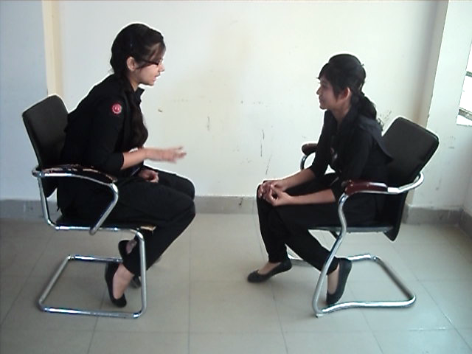
But why English Newspaper?
English is very important.

Slide 12
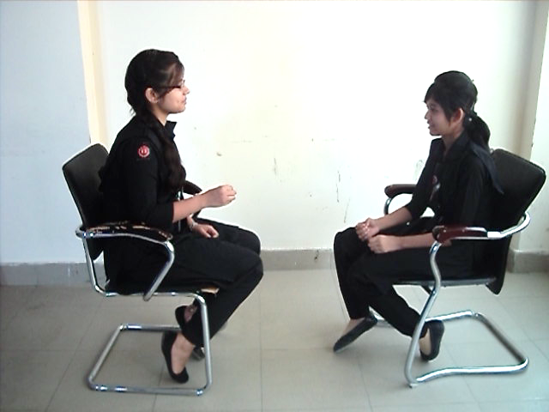
What do you mean?
It is an international language.

Slide 13
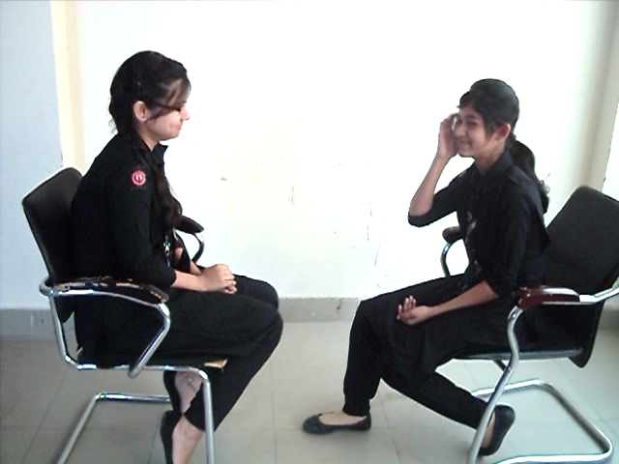
Yes. I know.
Do you know the importance of English?

Slide 14
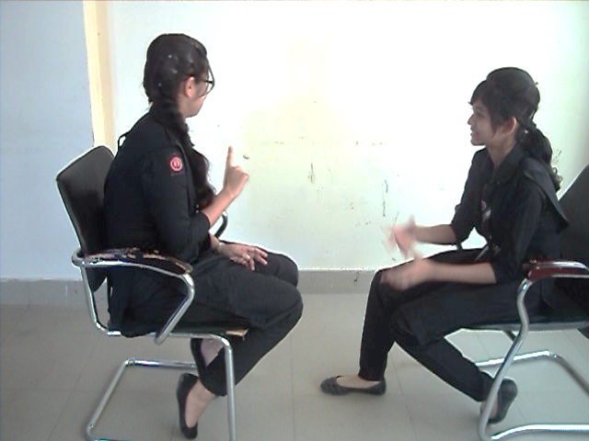
I know a little bit.
Do you explain more ?
Sure!
The world cannot go for a single day without English.

Slide 15
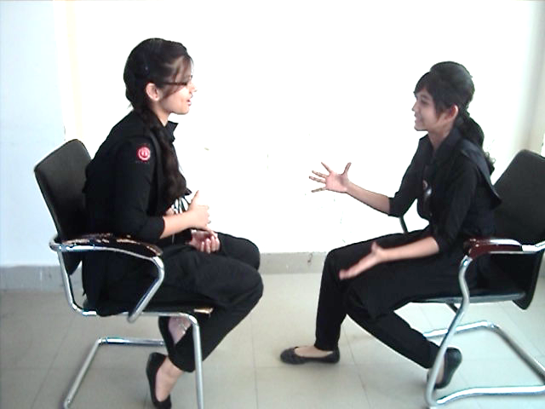
O, I see.
Exactly. Most of the people of the world speak in English.

Slide 16
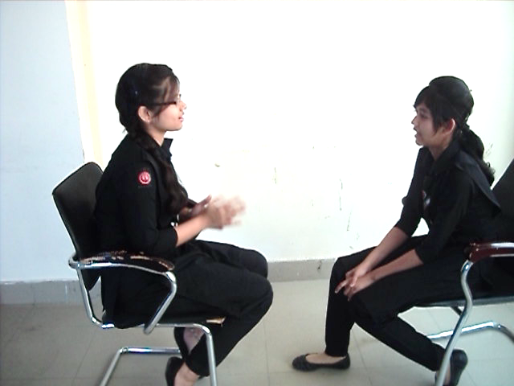
Only speak ?
No, Most of the books and documents are also written in English.

Slide 17
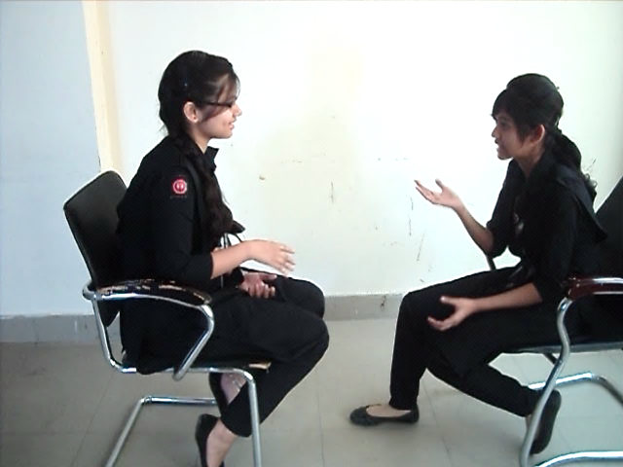
What should we do?
We should learn English.
Moreover, it is the language of ICT .

Slide 18
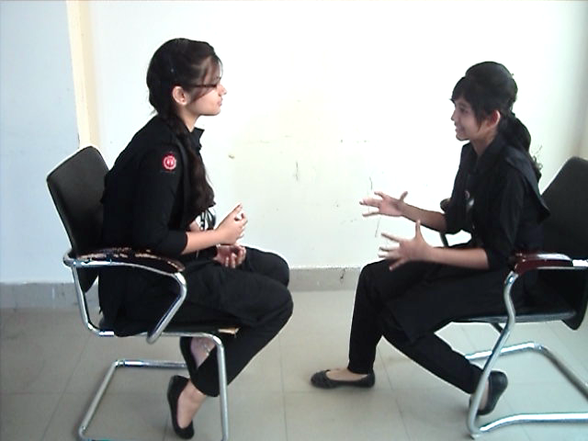
How is it related to ICT?
All ICT activities are conducted in English.

Slide 19
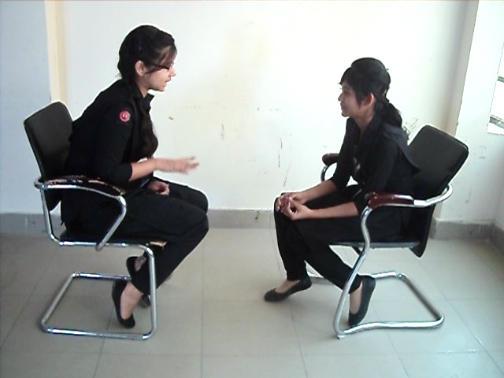
Anything more?
If you want to keep pace with the world, there is no other alternative to learning English.

Slide 20
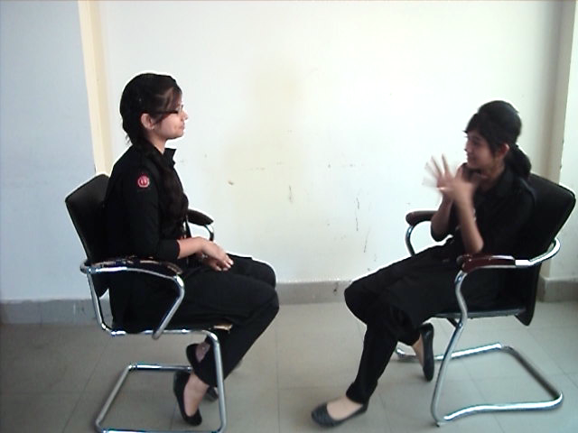
Yes, You have told the right.
Thank you.

Slide 21
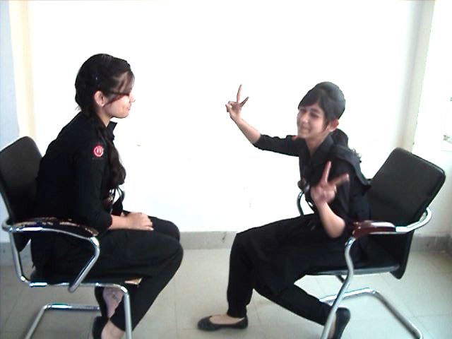
You are most welcome.

Slide 22
Pair Work
Every single pair is told
to write a dialogue on,
“ The Importance of Learning English.”

Slide 23
Evaluation
Answer the following questions-
What language is called the International language?
Why is it called the International language?
Why should we learn English?
How is English related to ICT?
What should we do to develop our English skills?

Slide 24
Homework
Make a dialogue with your friend about
“The Importance of
Learning English”

Slide 25
Advice
“Learn English,
Be smart”

Slide 26
Bye bye
Good bye

